Slide 1
Goal Setting/ Pre-Mortem
End the Syndemic Project

Slide 2
Goals

Slide 3
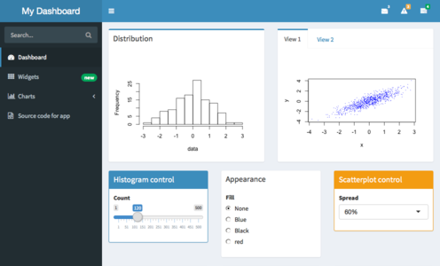
A Dashboard: (MVP)
A basic goal of ours is to e Examine endemic factors and promote syringe exchange programs.
We hope to accomplish this primarily through Build an interactive dashboard which we will work with our partner to plan.
The dashboard will provide county by county data as well as and state level data. We’re still working with our partner to decide whether it will be public or private and who will maintain it.
Example Dashboard

Slide 4
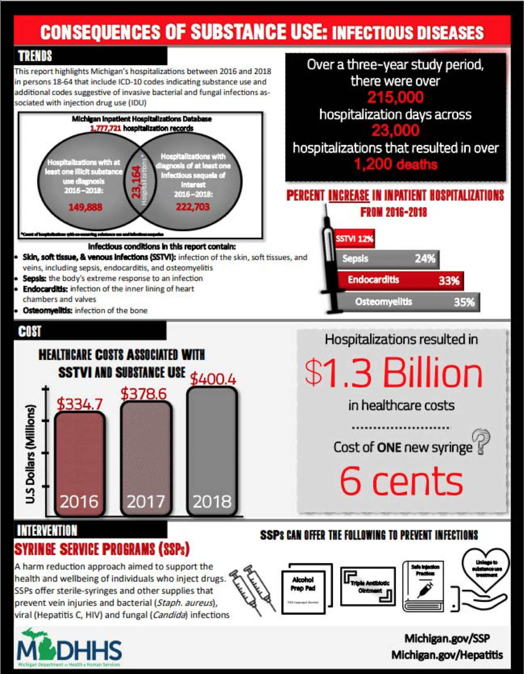
Major Visuals: (MVP)
As part of our project, our partner would like to have the visuals to make informational flyers
We hope to Provide simple, valuable graphs and visualizations that could be used to create flyers and a one-pager similar to the Michigan Study.
This includes graphs with cost of treating each health area versus expected cost for syringe exchange programs as well as graphs relating factors like race, age, etc to endemic factors.

Slide 5
One-Pager: (Aspirational)
As shown, the reference point for our final project is the Michigan one-pager. Produce a one-pager similar to the Michigan Study.
We hope to be able to put the one pager together ourselves.

Slide 6
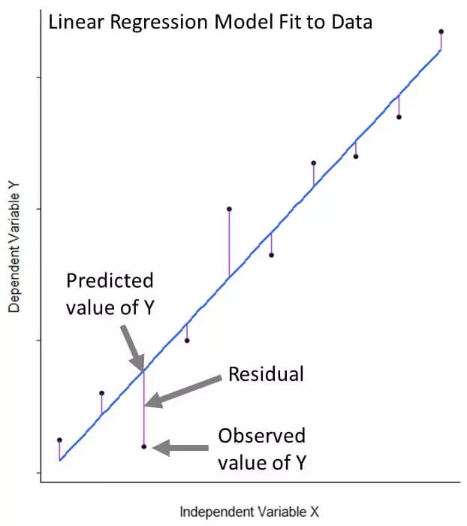
Predictive Models: (Aspirational)
Our client will be using our data to lobby for future change.
It is an aspiration of ours to Provide models that can predict trends for future use.
Example Predictive Model

Slide 7

Building a Relationship: (Aspirational)
Since Datalab tends to have very good relationships with their partners, but our partner is so busy, we hope to develop some sort of relationship with her and her cause.
We hope to build a better foundation for communication in the future.
Amber Coyne

Slide 8
Pre-Mortem

Slide 9
Data Size:
Problem:
The data is incredibly large!
The data can be hard to comprehend.
Our hardware is struggling to run it all.
Solution:
Set goals for key data points we need to focus on and refine that. Quality over quantity!
Work with tech staff and university resources to use new hardware.
Notes:
Data is large, data is complicated. Work with staff, hone in on key points.

Slide 10
Our Partner’s Schedule:
Problem:
Despite efforts to reach out to our partner, we have not been able to meet with her yet.
Additionally, we’ve been given a handful of different benchmarks for what success looks like.
Solution:
Continue to reach out to her and make plans for meetings so that we can use our time most efficiently.
Request assistance from leadership in getting her attention.
Work with Mr. Peterman more intensely, who has knowledge of the project and of Amber.
Notes:
Our partner is busy; goals are scattered. Reach out, reach out, reach out. Talk to Peterman and other leadership.

Slide 11
Predictive Models:
Problem:
Although predicting trends is an aspirational goal of ours, it is not something we have the most experience in.
The consequences for Incorrect analysis could misleading our partner and lawmakers could and hinder the advocacy work for syringe exchange clinics, which defeats our purpose.
Solution:
We will Consult with Datalab’s technical staff and allow them to help guide our next steps.
If we decide not to produce the predictive model, we will let it be a starting point for future Datalab interns or Amber Coyne’s tech staff to pick up and work on.
Notes:
We don’t have experience, we could be dangerous with our data.

